Slide 1
Aung Myin Kyaw (Max) weekly Research Progress Report
Date : 06/10/2018 to 13/10/2018
Scope of the work:
Troubleshooting of last week issue

Slide 2
Research Progress in last week
As I presented last week, there is an error in printing of scanned data from the saved array. Initial finding shows that it was due to the difference in integration timing.
I have tried to set different integration timing to get the scanned data. However, there were no improved and the error still exists.

Slide 3
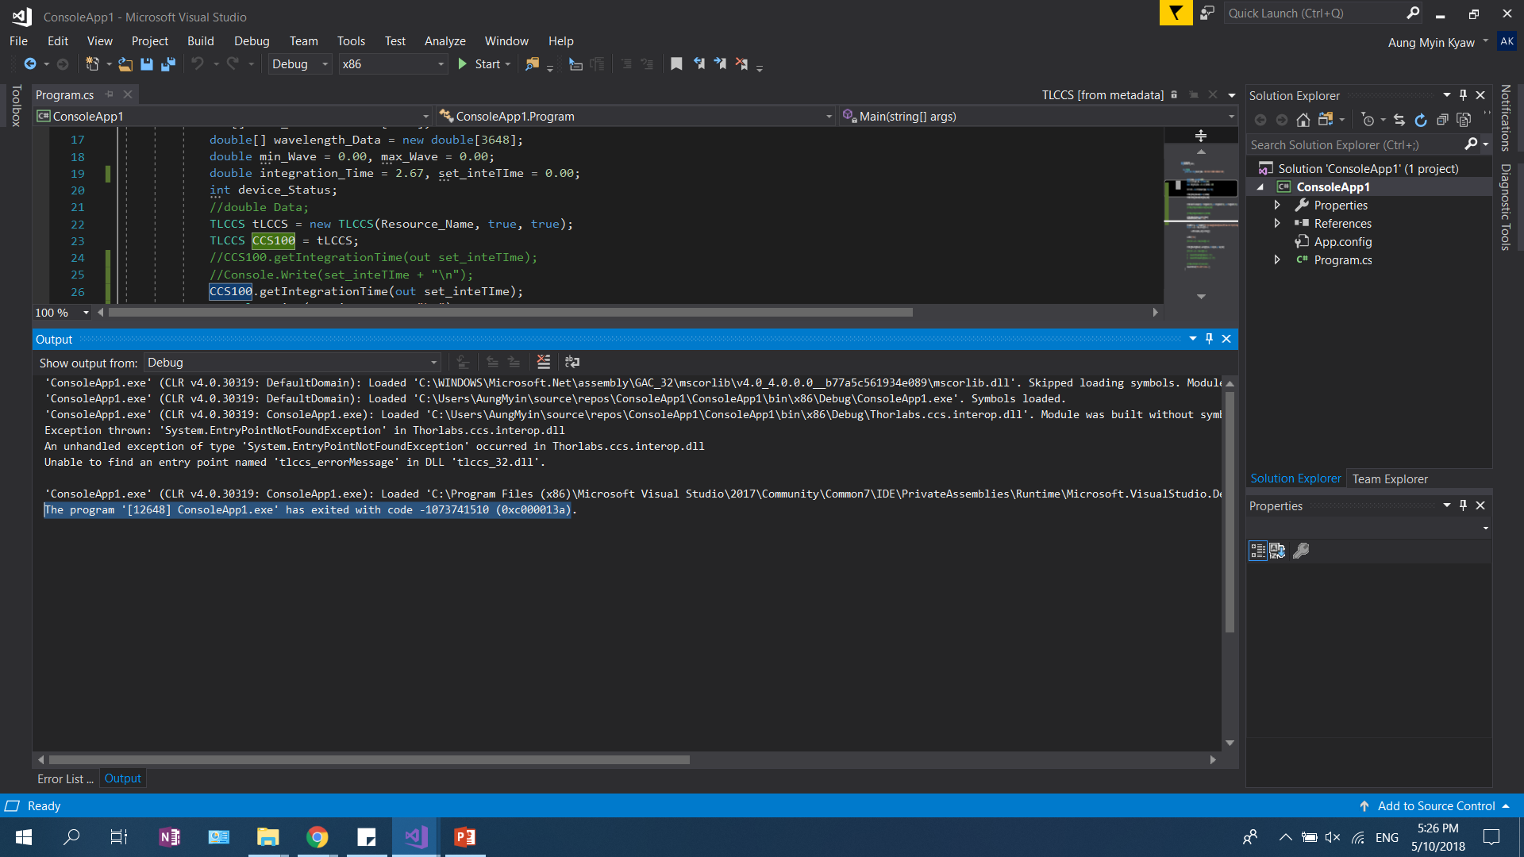
Research Progress in last week
I can conclude that the error is due to the missing function in the library that Thorlabs had set up. This is because the error message is “System.EntryPOintNotFoundException” occurred in Thorlabs.ccs.interop.dll (which is the library that Thorlabs provided for customization of the program)

Slide 4
Research Progress in next week
Since the error exist in the library there is very little that I can do to fix the issue. However, for next week I will try to experiment and find different ways to work around it. As there are no little information to help solve this issues, if I could not find a solution by next week, I will email Thorlabs again for advice.

Slide 5
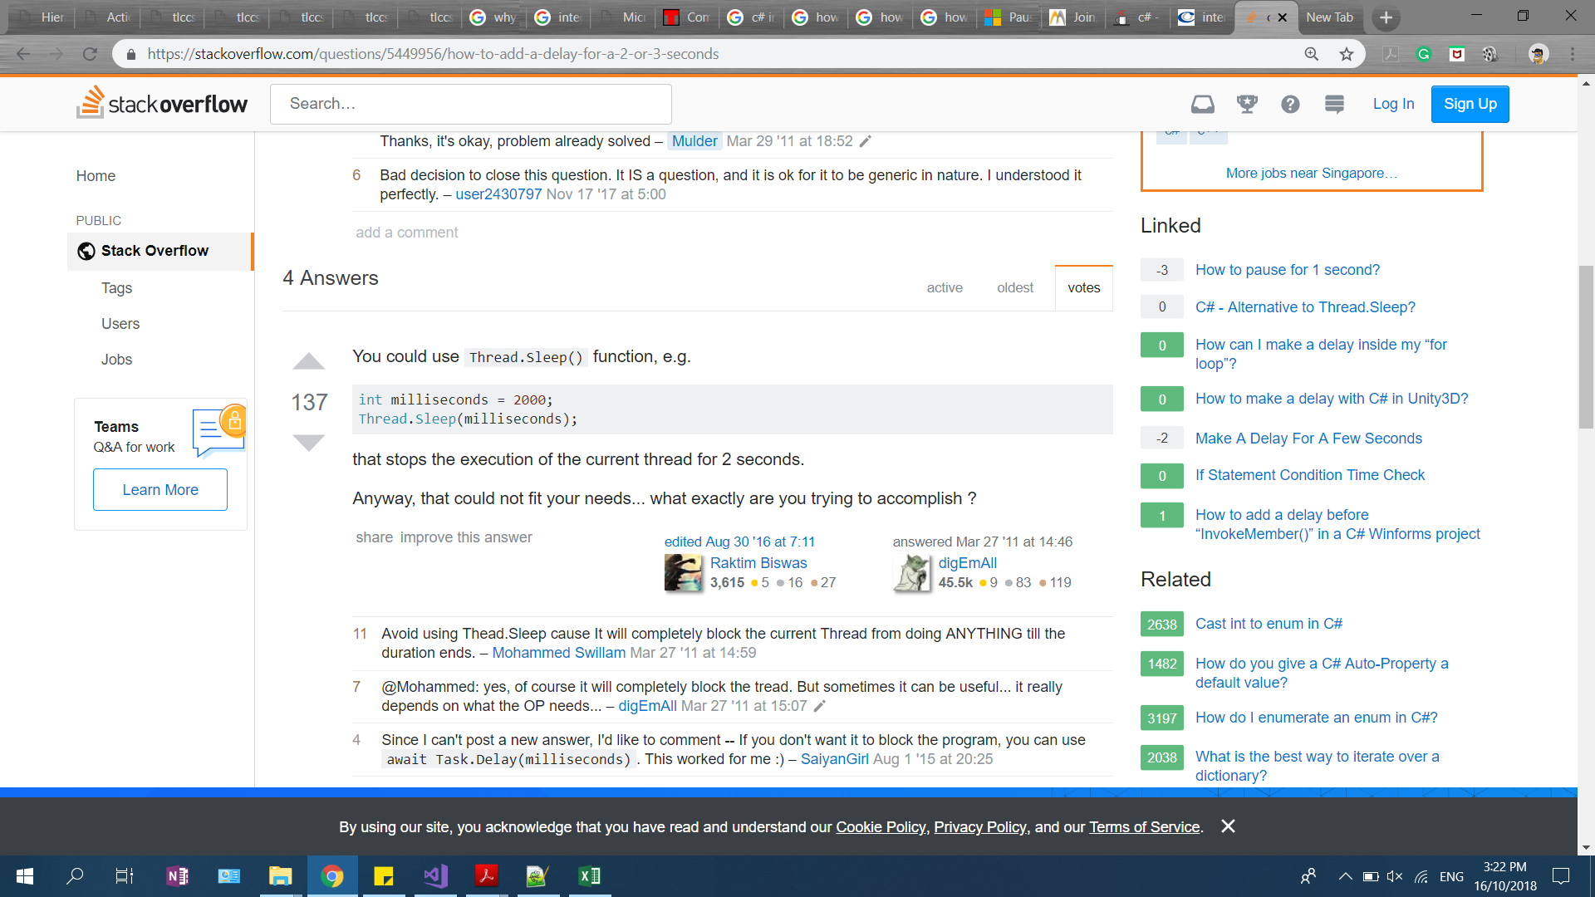
https://stackoverflow.com/questions/5449956/how-to-add-a-delay-for-a-2-or-3-seconds

